Slide 1
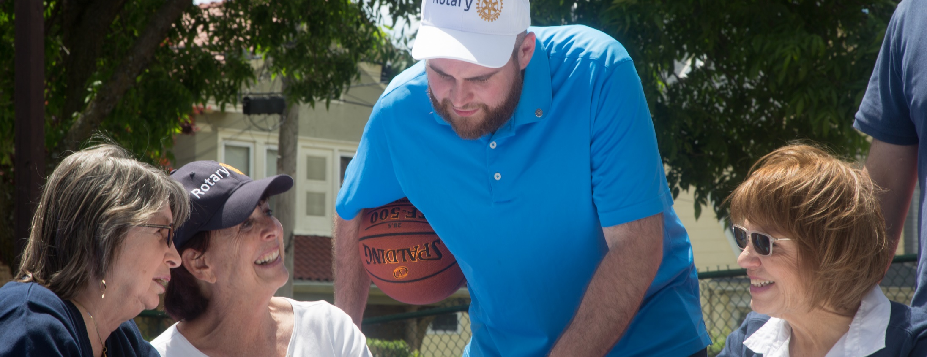
Doing Good In The World!
Your Rotary Foundation

Slide 2
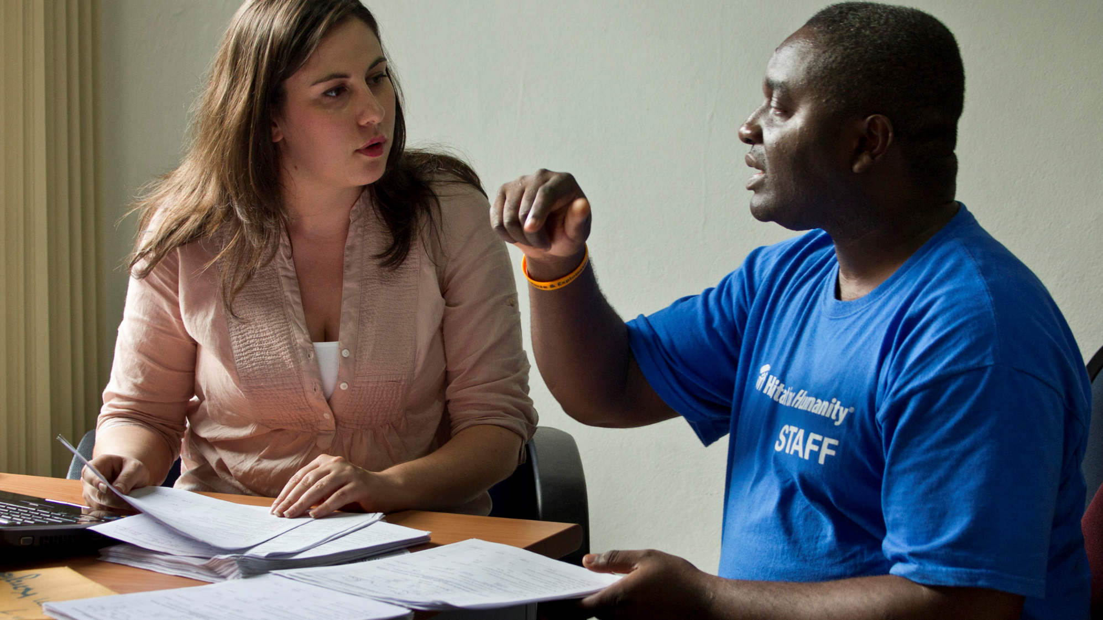
Our Mission:
The Rotary Foundation helps Rotarians to advance world understanding, goodwill, and peace by improving health, providing quality education, improving the environment, and alleviating poverty.

Slide 3
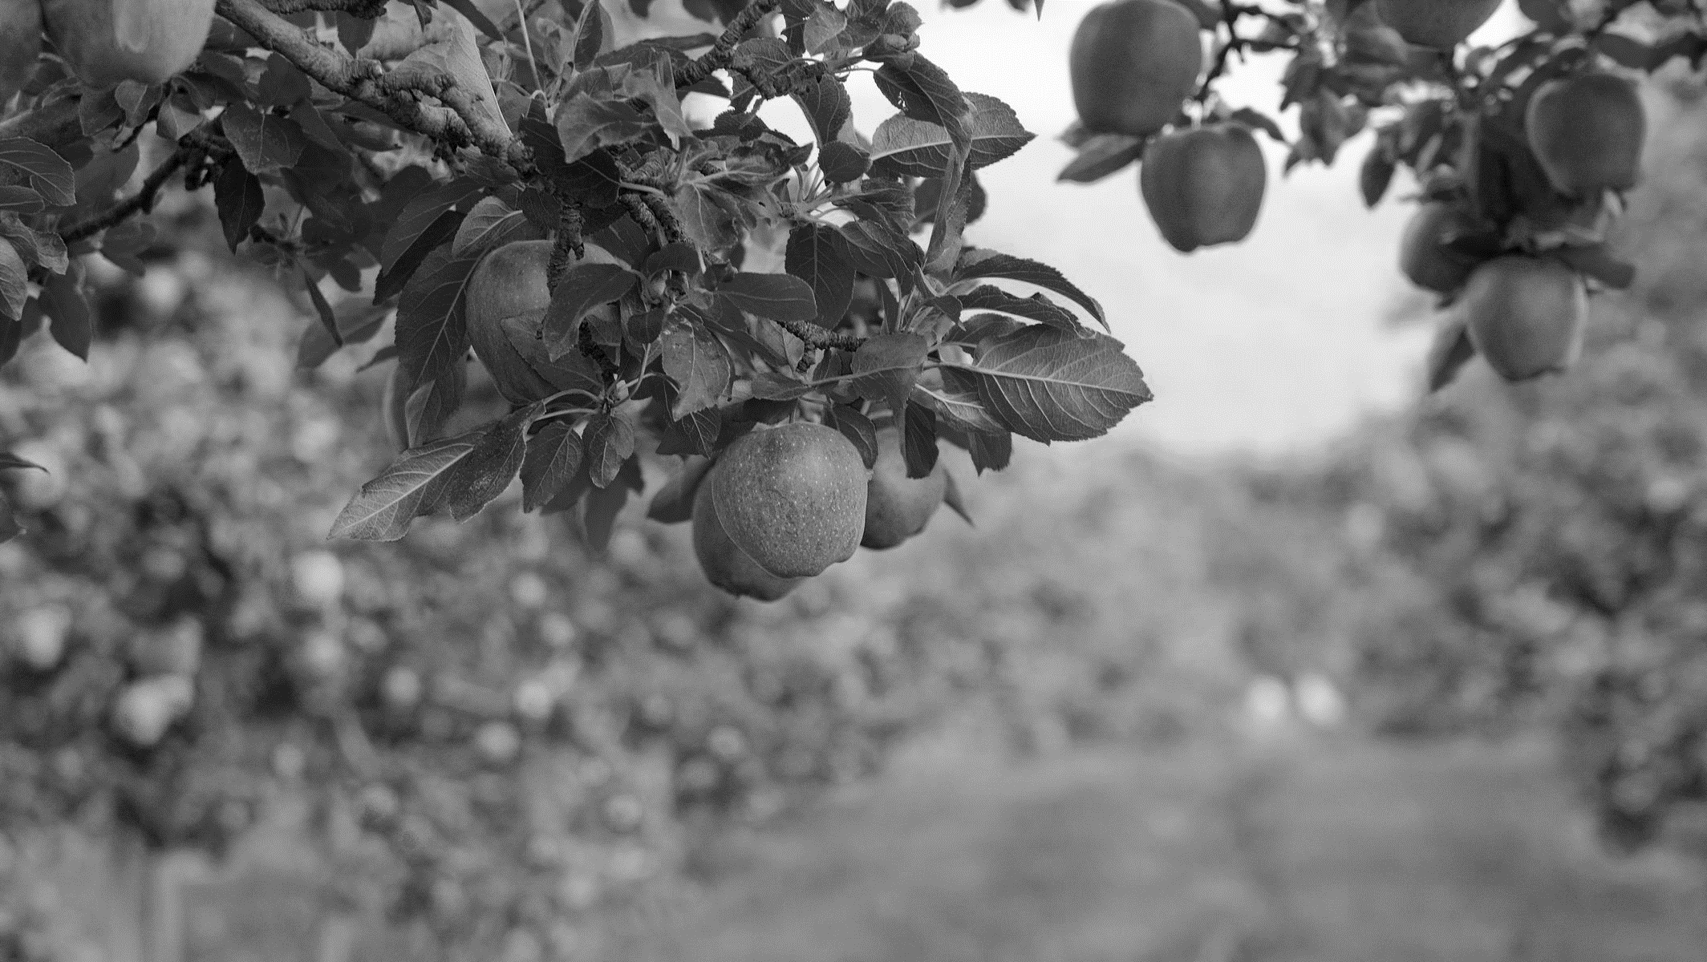


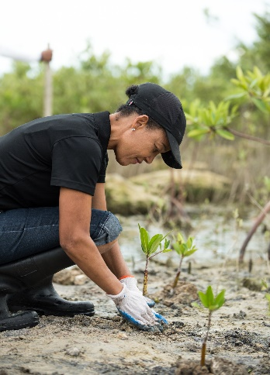
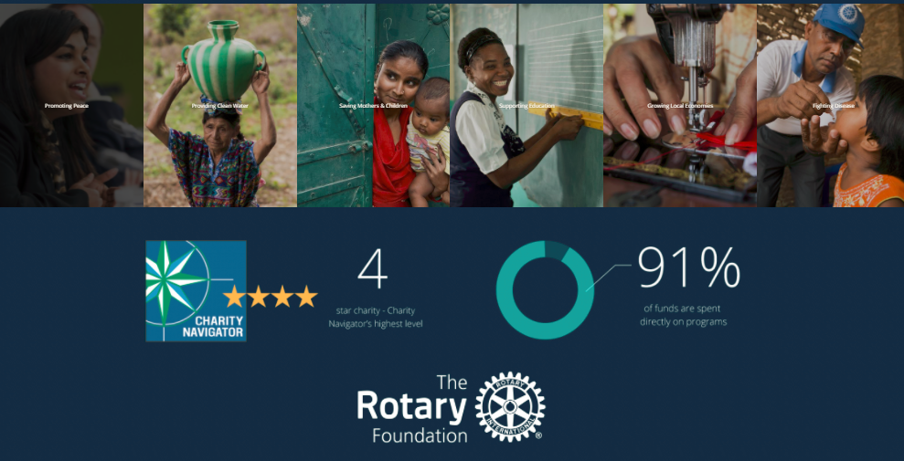
Protecting the Environment

Slide 4
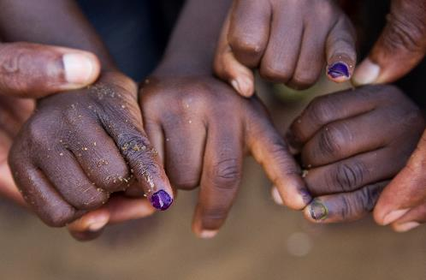
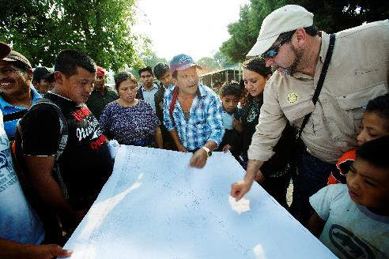
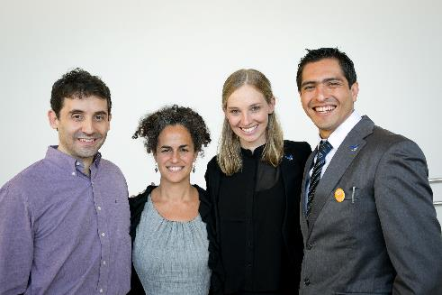
SUPPORTING THE ROTARY FOUNDATION
PolioPlus Fund
End Polio Now
Annual Fund
For Support Today
Endowment Fund
To Secure Tomorrow
Notes:
Rotarians can support three main funds:
The PolioPlus Fund, to help us eradicate polio worldwide.
The Annual Fund, to support Rotary’s work today.
The Endowment Fund, to support Rotary’s future work.

Slide 5







“Largest Health Footprint in the World”
Notes:
Rotary is a core partner of the Global Polio Eradication Initiative established in 1988 three years after Rotary launched PolioPlus in 1985. The Bill & Melinda Gates Foundation joined the partnership in 2007 and Gavi, the Vaccine Alliance joined in 2019. And of course, the GPEI works with governments of the world, both in donor countries such as the UK and Germany who provide critical funding for the effort, and polio-affected countries such as Pakistan and Afghanistan

Slide 6
Polio MIlestones
Polio cases reduced by 99%
20 million people either walking or alive because the global polio eradication effort
122 countries have received support from PolioPlus grants
Rotary has invested more than US$2.5 billion in global polio eradication efforts
“Delivering On A Promise” 2022-2026 GPEI Polio Eradication Strategy
Afghanistan and Pakistan-Last TWO Endemic Countries
Afghanistan Polio immunization continues – Access to ALL children
2022
1988

Slide 7
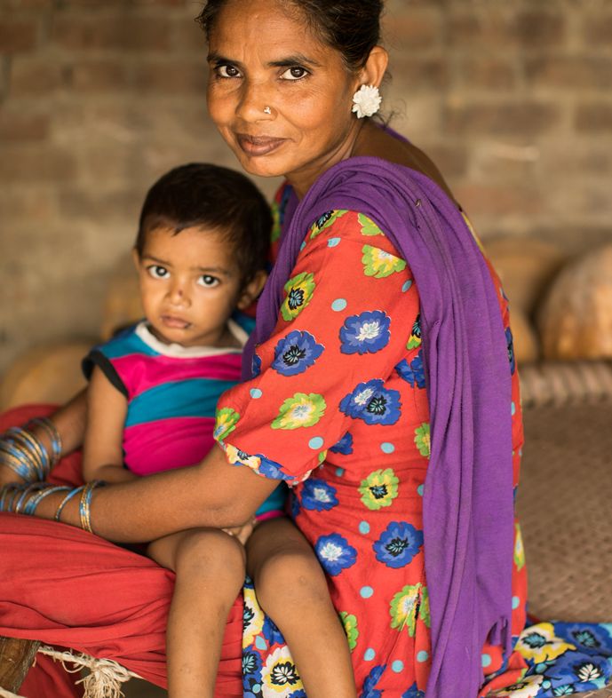
Positioning To Achieve Eradication
Immunizing More than 450 million Children in up to 60 Countries Each Year
Funding over 150,000 Polio Workers in up to 70 countries Each Year
Continuing Disease Surveillance Activities in more than 70 Countries

Slide 8









Our Causes
Notes:
Although how we describe our efforts over the years, the heart of the Rotary mission has always been Peace and Conflict Resolution. Currently our Causes are reflected above and also include are
-Peace and conflict resolution.
-Disease prevention and treatment.
-Water and sanitation.
-Maternal and child health.
-Basic education and literacy.
-Economic and community Development.
our newest and certainly one of our most important causes is
Protecting the Environment

Slide 9


Why we Rotary?
Fellowship
Leadership
Integrity
Diversity
Service
Notes:
So, what why do we Rotary. Doing good things in our towns and the world is great and it does not take a deep google dive to find studies on the psychological and physical benefits of altruism, but why else?
Fellowship
Integrity
Diversity
Service
Leadership

Slide 10







rotary.org/flexibility
Notes:
So from Chicago in 1905, Rotary has put over 115 years into trying to lend a hand when they see a place for it and giving those, like you, the voice to do something to make immediate change when they see an opportunity.

Slide 11
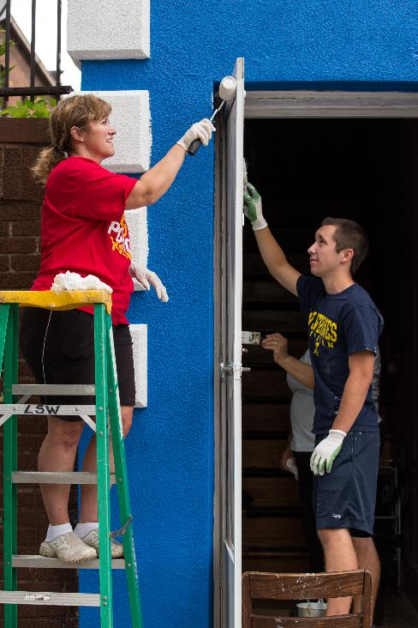

Annual Fund
SHARE World fund Areas of Focus
Primary funding source for Rotary Grants and Programs
Contributions to Annual Fund SHARE generate District Designated Funds (DDF)
Contributions are credited to the donor, donor’s club, and applied to club’s goal
Notes:
Contributions to the Annual Fund support local and international grants and activities through the SHARE system.
Contributions are credited to the individual donor and the donor’s club and counted toward the club’s and district’s Annual Fund goals.

Slide 12
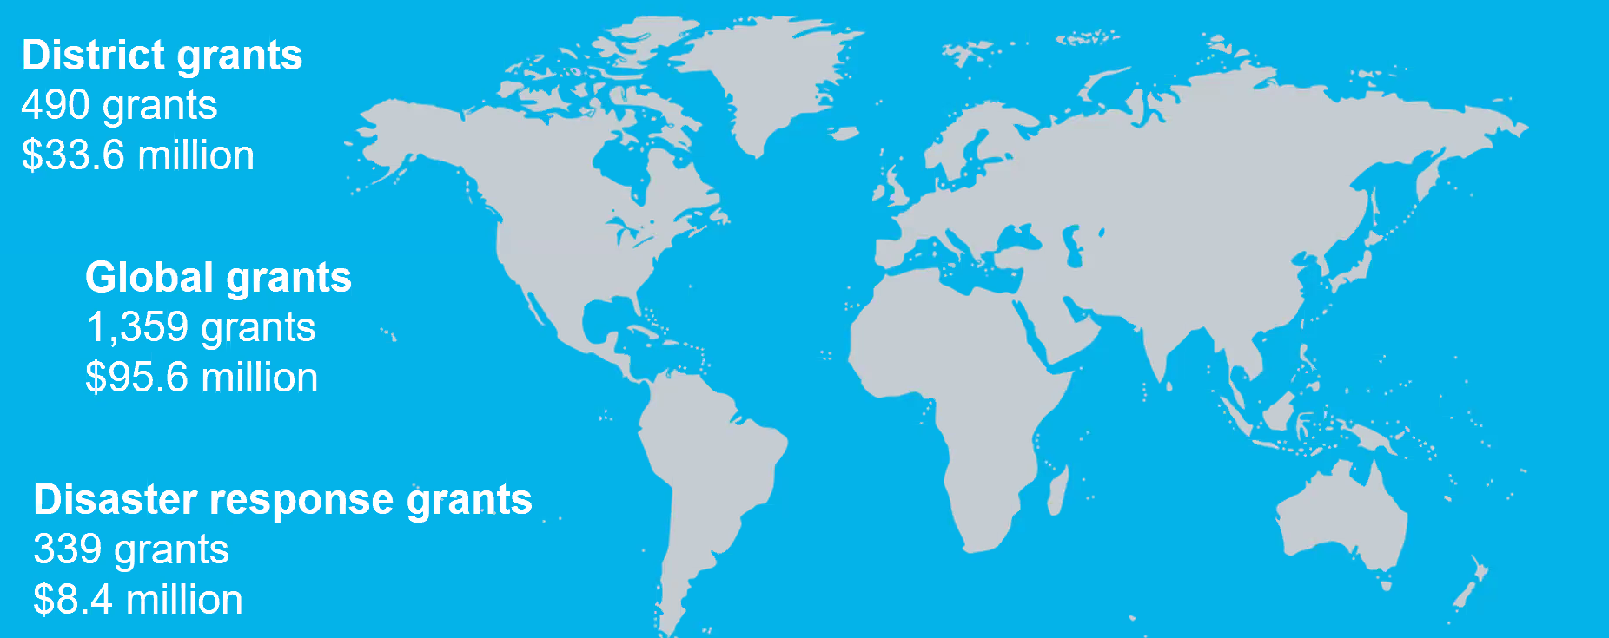
2021-22 Grant statistics*
District Grants
451
$28.1 Million
Global Grants
970
$63.6 Million
Ukraine Disaster
Response Grants **
181
$5.8 M
*As of May 2022
**As of July 2022

Slide 13
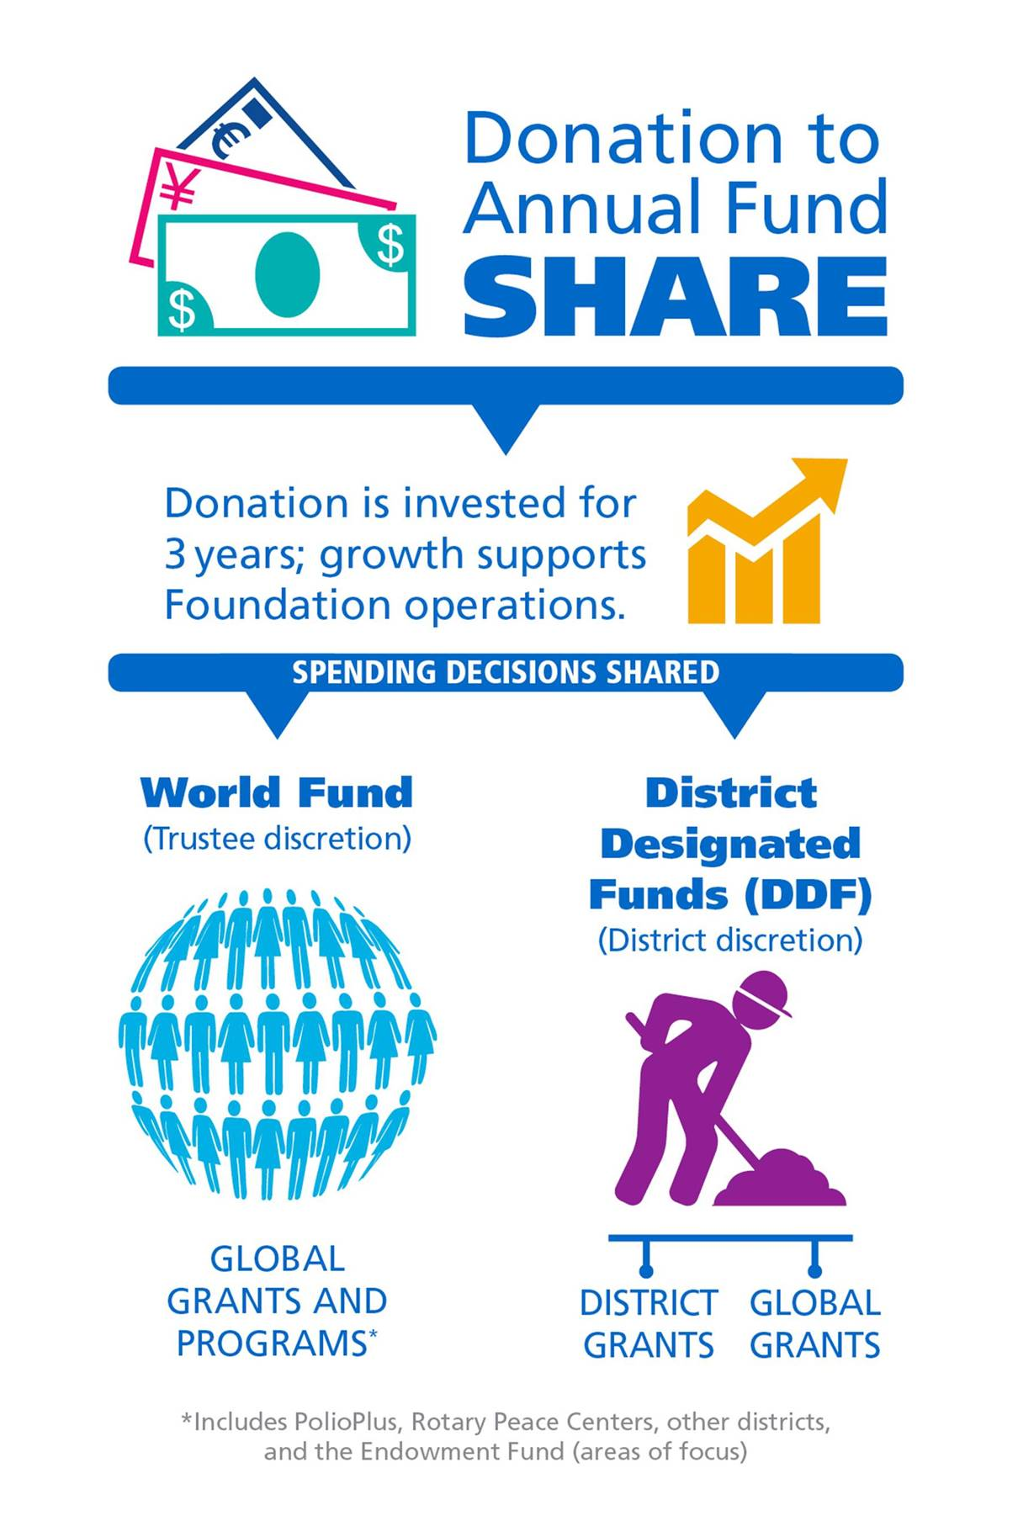
Annual fund share

Slide 14
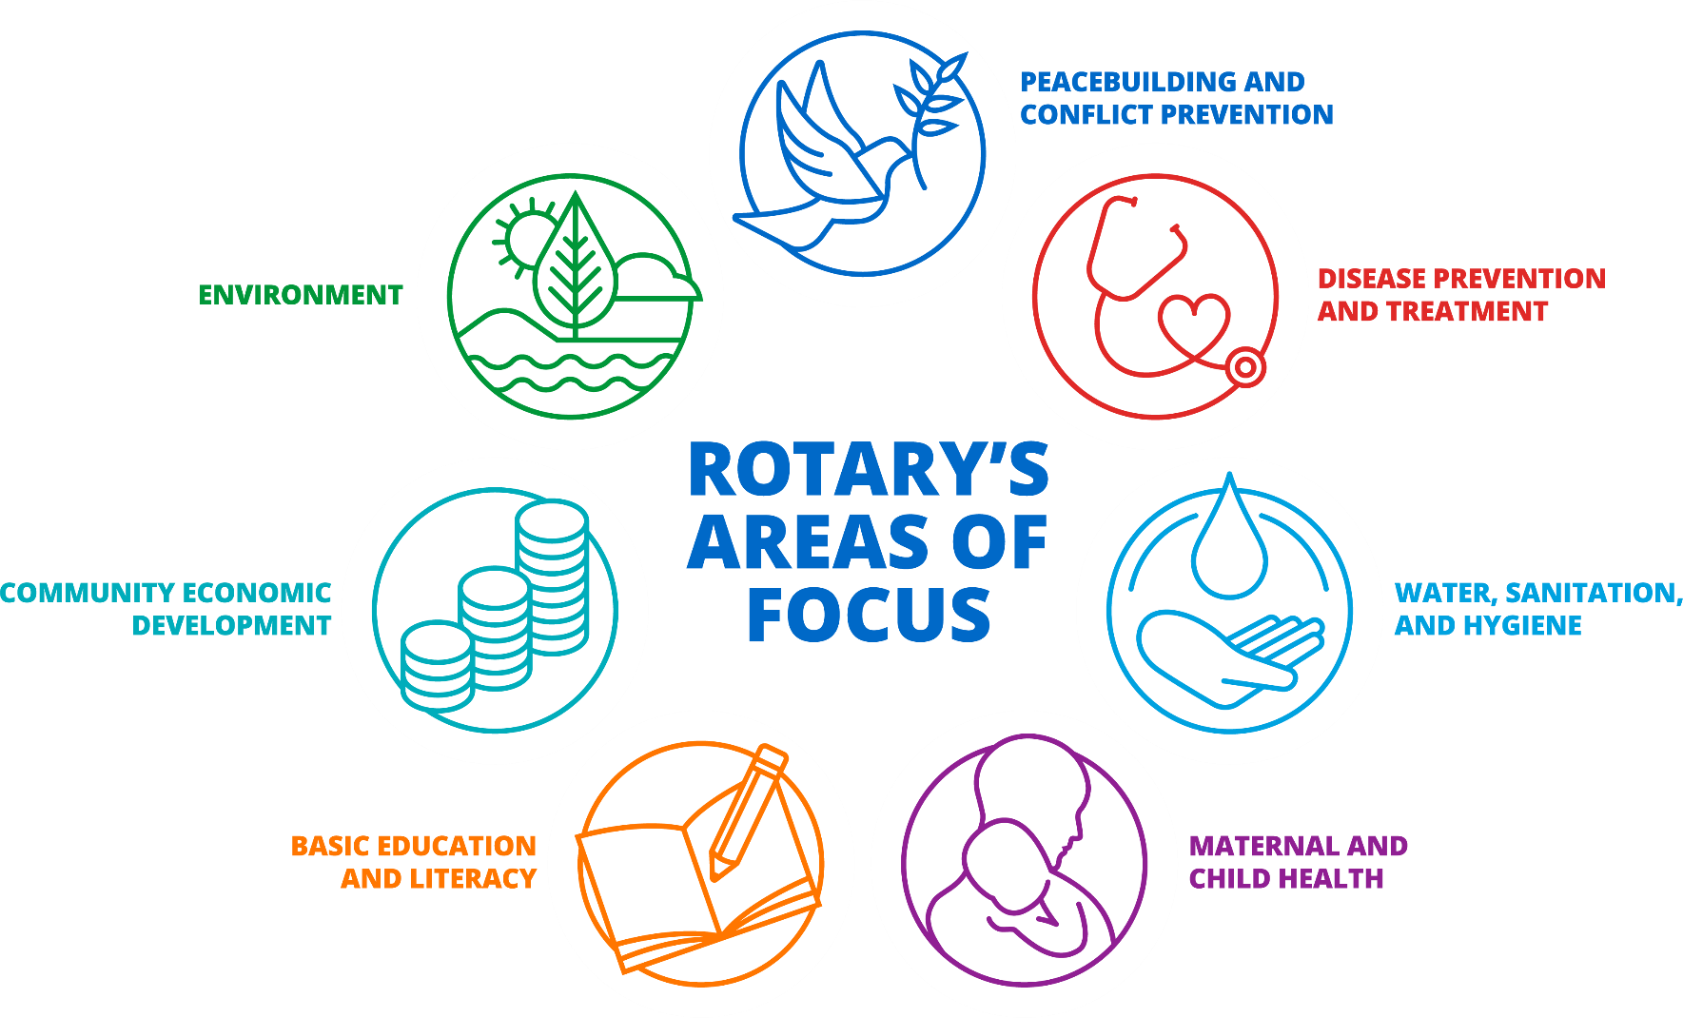
Rotary areas of focus

Slide 15
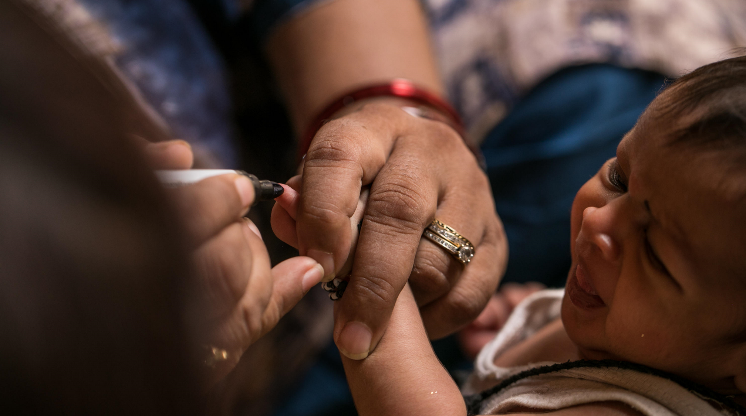
subhead
How Can I Support The Causes I care About Today?
  Checks, Credit Cards
  Rotary Direct
  Pledge
  Gift of Stock
  IRA (Qualified Charitable Distribution)
  Donor Advised Fund

Slide 16
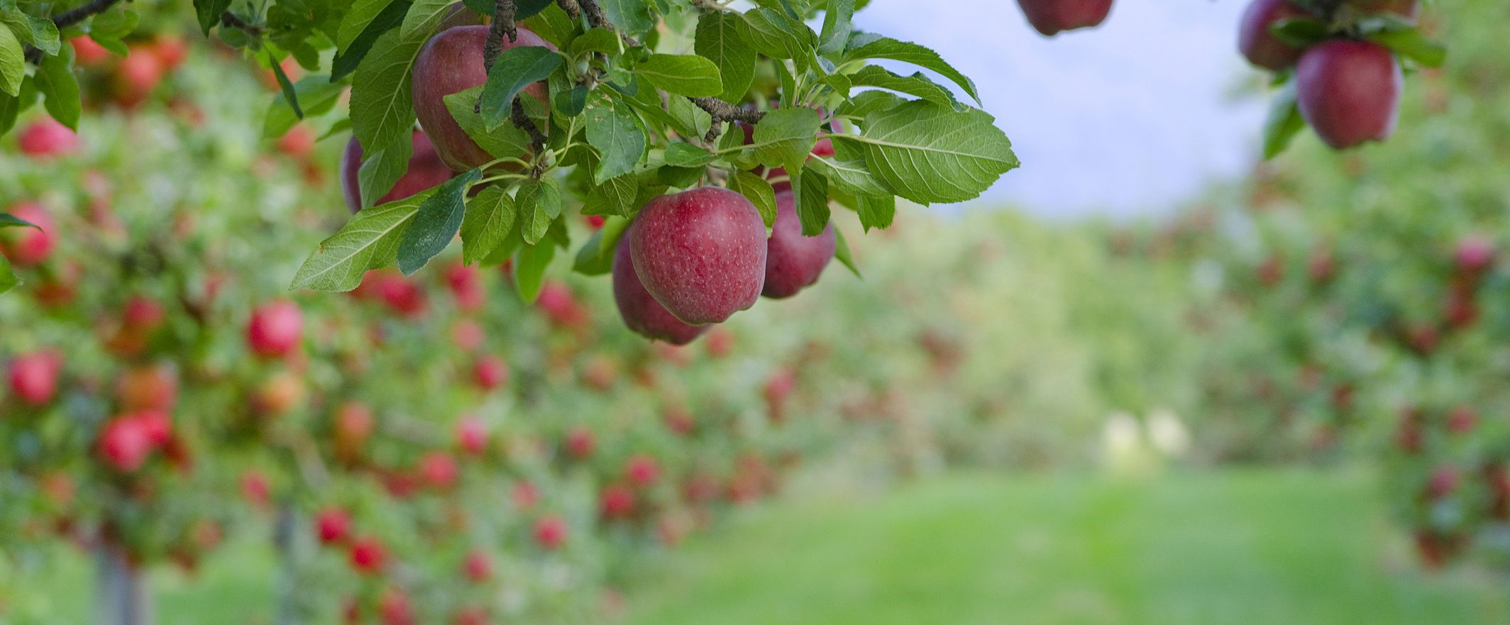
Leaving A Legacy
The Rotary Foundation Endowment

Slide 17

How Does the endowment work?
Gifts Are Invested Forever
Generate “Spendable Earnings” In Perpetuity
Long Term Impact
Personalize Your Gift

Slide 18
  Naming Rotary in a will or living trust
  Retirement plan beneficiary designation
  Life insurance beneficiary designation
  Charitable Gift Annuity, Charitable Remainder Trust
Including the rotary foundation in your estate plan

Slide 19



THE ROTARY FOUNDATION IMPROVES THE MEMBER EXPERIENCE
Club members
DISTRICT GRANT
Help a community
GLOBAL GRANT
Make a bigger impact
Notes:
There are a multitude of subjects to include in your so thank you ahead of time for including content on The Rotary Foundation. It’s important for a few reasons:
First, our Foundation is a source of pride due to the positive impact it continues to have on the world. Over the last 100 years, the Foundation has spent over $4.5 billion on life-changing, sustainable projects. In 2018-19 over 1,400 global grants ($86.6 million) in the areas of focus, around 500 district grants ($26.3 million) and close to 100 Rotary Peace Fellowships were awarded.
Second, the positive impact isn’t limited to the beneficiaries, it changes and improves the lives of the Rotarians who become involved and in many cases passionate about the Foundation’s programs. I witness this every day at work and in my own club.
I wanted to remind you all that TRF improves the membership experience for Rotarians. It is great avenue to make a difference locally and globally in ways that one couldn’t do on their own. You can help to rally clubs around supporting projects. TRF is one way Rotarians make those vibrant projects happen which then inspires people to become and remain Rotarians.

Slide 20
Features of a District Grant
A single block grant awarded annually for club and district projects
Local or international activities
Local decision making with broader guidelines
Smaller activities and projects
Notes:
District grants are single, annual block grants made to districts in amounts up to 50 percent of their District Designated Fund (DDF).
The district grant can fund multiple club and district projects, which may be local or international.
District grants allow local decision making, with minimal restrictions, for smaller-scale activities and projects.

Slide 21
Features of a Global Grant
Align with an area of focus
Respond to a community need
Must have a host club in the country of the project and an international club
Strengthen knowledge, skills, resources
Have long-term, sustainable benefits
Produce measurable results
Online application through TRF
Minimum budget of at least $30,000
  DDF allocation is matched 80%
Notes:
The minimum grant award is $15,000 (for a total budget of at least $30,000). The DDF allocation is matched 100 percent, and cash is matched at 50 percent from the World Fund. A global grant project is sponsored by a host club in the project country and a club outside the project country.

Slide 22
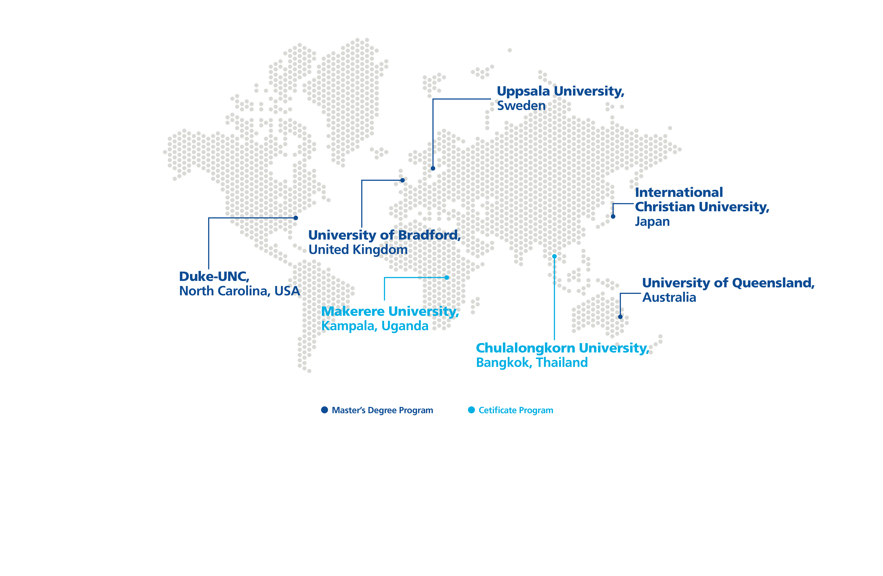
Rotary peace centers
More than 1,500 program alumni (Rotary Peace Fellows) are working on peace and development in more than 115 countries.
Master’s Degree Program
Certificate Program
New Rotary Peace Center Coming Soon!

Slide 23
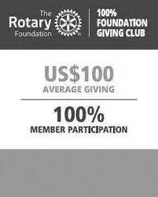

Club Recognition
100% Foundation Giving
  Achieve an average of $100 per capita giving and 100% participation with $25 average per dues paying member of contributions to Annual Fund, Polio Plus, Global Grant or Endowment Fund
100% Every Rotarian, Every Year
  Minimum Annual Fund contribution of $100 per capita and every dues paying member must personally contribute at least $25 to Annual Fund during the year
Notes:
Like individual donors, clubs generously contribute to The Rotary Foundation. Recognizing and thanking clubs helps build a culture of giving among members.
Club banners are sent to the sitting district governor; many governors choose to present banners to clubs at Foundation dinners or district conferences:
100% Foundation Giving Club: This banner is awarded to clubs that achieve a $100 average and 100 percent participation, with every dues-paying member contributing at least $25 to any or all of the following during the Rotary year: Annual Fund, PolioPlus Fund, approved global grants, and Endowment Fund.
Every Rotarian, Every Year Club: This banner is awarded to clubs that achieve $100 per-capita giving and 100 percent participation, with every dues-paying member contributing at least $25 to the Annual Fund during the Rotary year.
Top Three Per Capita Clubs: Banners go to the three clubs in each district that give the most, per capita, to the Annual Fund. Clubs that give at least $50 per capita are eligible.
100% Paul Harris Fellow Club: For clubs in which all dues-paying members are Paul Harris Fellows. This is a one-time recognition.
100% Paul Harris Society Club: This recognition is awarded to clubs in which every dues-paying member has contributed a minimum of $1,000 outright to the Annual Fund, PolioPlus Fund, or an approved global grant during a given Rotary year.

Slide 24
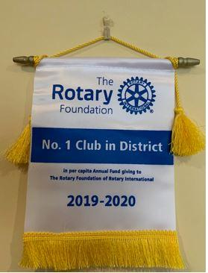

Club recognition
Top Three Per Capita Clubs in Annual Fund Giving
  Clubs must achieve a minimum of $50 in per capita annual giving
100% Paul Harris Fellow Club
100% Paul Harris Society Club
End Polio Now Certificate

Slide 25


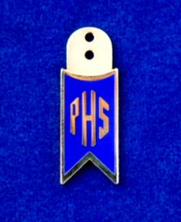
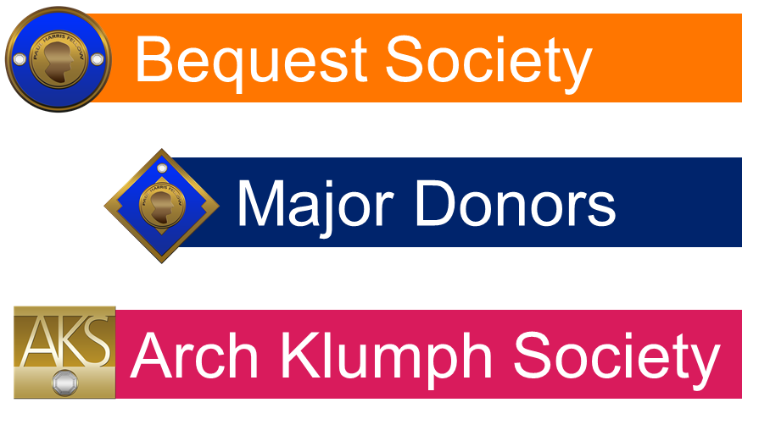

Recognizing Rotarians!

Slide 26
Paul harris fellow
Paul harris society
Rotarians achieve PHF- PHF+8 at subsequent $1000 levels ($1=1 PHF Point):
Personal Contributions to Annual Fund, Polio, or approved Global Grant
Receiving Points from other Rotarians
Club and District Matching Programs
A Rotarian receives PHS recognition when they notify TRF of their intention to contribute $1,000 cash each year to the Annual Fund, PolioPlus, or approved Global Grant

Slide 28
D7620 Legacy Campaign Designation Totals
Designation Area | Amount
D7620 Named Endowment | $175,000.00
I-EFSH | $387,000.00
I-AFSH | $98,160.32
I-EFWF | $149,153.40
I- AF MCH | $10,000.00
I-EF DPT | $6,216.92
I- EF WASH | $456,217.91
I- EF ENV | $450,000.00
I- EF BEL | $381,216.92
I- Polio | $25,000.00
I- EF MCH | $11,216.91
I Disaster Fund | $20,000.00
I-WF | $30,000.00
Global Grants | $337,013.62
Total | $2,536,555.00
I= Individual | **EF Gift Totals can be a combination of Outright and Bequests with the exception of the D7620 EF which are all outright gifts

Slide 29
Barton= $362,581.87
Jimmie= $702,846.34
Geetha= $1,471,126.79

Slide 30

Imagine rotary!
Geetha Jayaram DRFC District 7620

